Slide 1
Human factors or Ergonomics
The International Ergonomics Association defines ergonomics or human factors as follows:
Ergonomics (or human factors) is the scientific discipline concerned with the understanding of interactions among humans and other elements of a system, and the profession that applies theory, principles, data and methods to design in order to optimize human well-being and overall system performance.
Human factors and ergonomics is concerned with the ‘fit’ between the user, equipment and their environments. It takes account of the user's capabilities and limitations in seeking to ensure that tasks, functions, information and the environment suit each user.

Slide 2
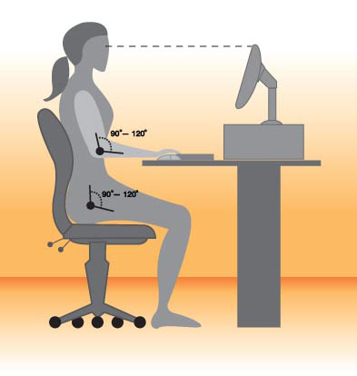
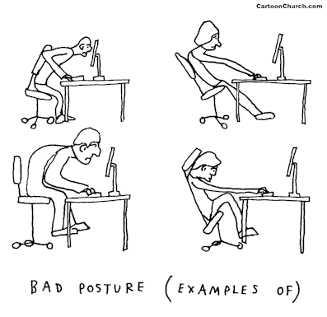
Examples

Slide 3
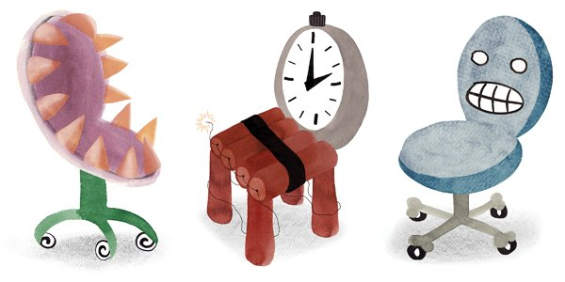
Don’t Just Sit There

Slide 4
The Ergonomic College Research Articles & News Program
Confirmed: He Who Sits the Most Dies the Soonest
http://www.theatlantic.com/health/archive/2012/04/confirmed-he-who-sits-the-most-dies-the-soonest/256101
Don’t Just Sit There
http://www.nytimes.com/2012/04/29/sunday-review/stand-up-for-fitness.html
Is Sitting a Lethal activity?
http://www.inc.com/jessica-stillman/be-smarter-get-up-and-walk-around.html
Your Desk Is Making You Stupid
http://www.inc.com/jessica-stillman/be-smarter-get-up-and-walk-around.html
Minn. Researchers study standing vs. sitting at a desk
http://minnesota.publicradio.org/display/web/2012/01/24/sitting-vs-standing-study/
Is sitting the new smoking? MPR Daily-Circuit May 29, 2012
http://minnesota.publicradio.org/display/web/2012/05/29/daily-circuit-does-sitting-kills/

Slide 5
The Ergonomic College - Sit to Stand Work Surface Examples

